Slide 1

Life Lessons Primary RSHE
Information for parents

Slide 2

Contents
What is RSHE?
Why is RSHE so important and how will your child benefit?
What government guidance do we follow?
What is the Life Lessons approach?
What content will we cover?
What skills will we teach?
How do we deal with sensitive topics?
What is the guidance around sex education?
How can you support your child around these issues?

Slide 3
What is RSHE?
RSHE = Relationships, sex, health education
You might have also heard of PSHE, which includes everything in RSHE, plus some extra topics, such as communities, identity, body image and financial education:
PSHE = Personal, social, health and economic education

Slide 4
Why is RSHE so important and how will your child benefit?
RSHE was not a priority when most of us went to school, but now it is a government requirement. Students are exposed to huge amounts of information online.
Great RSHE lessons prepare students for the world that they live in:
Understand themselves better
Form healthier relationships
Understand and respect other people
Manage risks and avoid harm
Express themselves more clearly
Better wellbeing

Slide 5
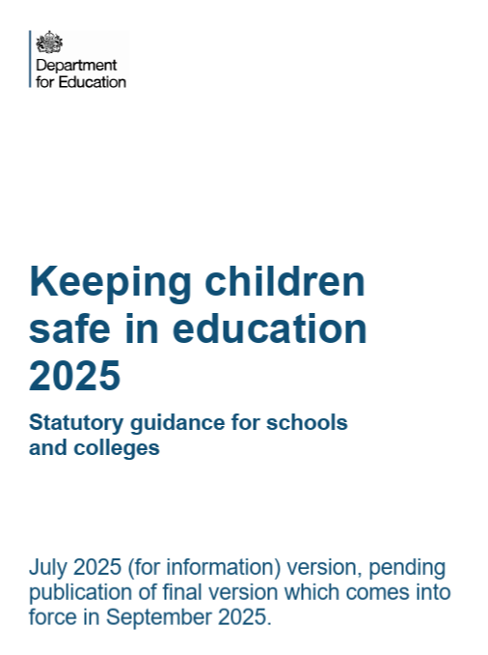
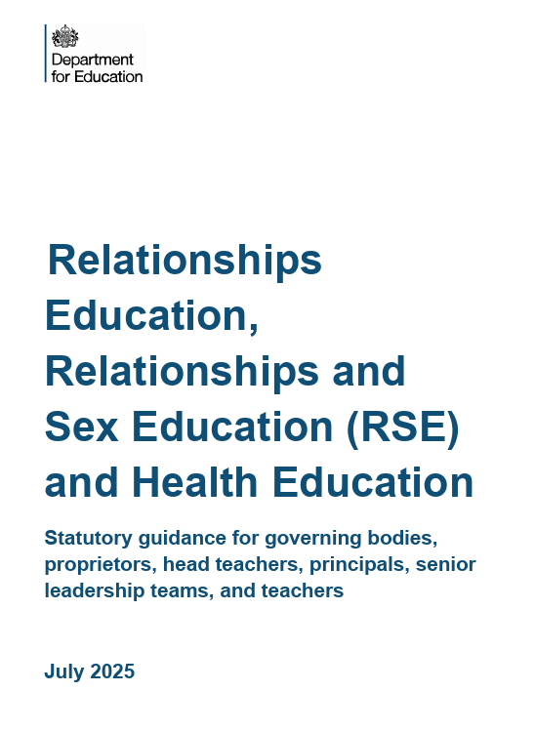

What government guidance do we follow?

Slide 6
What government guidance do we follow?
The government guidance for RSHE has changed (coming into effect in September 2026).
Although this is not radically different to the previous guidance, there are some changes to the guidance, such as:
Increased focus on addressing sexual violence and misogyny.
Specific wording about gender identity, and gender reassignment.
More detail about the impact of AI and social media.
More emphasis on emotional understanding, including loneliness

Slide 7
What is the Life Lessons approach?
Positivity
Stories
We want young people to feel positive about the future
We use stories to help young people prepare for the real world and understand other people.
Student-led
We want young people to feel like this is a curriculum for them and to develop their own voices and thoughts
Inclusive
Relational
We want all students to learn and feel like they belong
People learn through the relationships with the people around them.

Slide 8

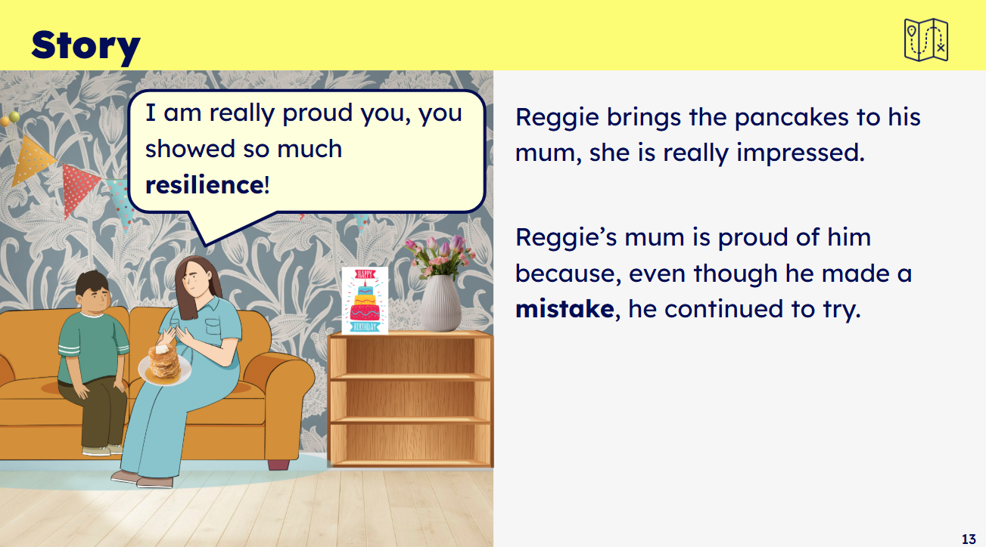

What is the Life Lessons approach?
Positivity
We want young people to feel positive about the future
We always provide a positive framing or outcome for all issues, even if the lesson is tackling something serious or sensitive.
Example from a year 2 lesson, which encourages young people to be resilient when faced with challenges and to feel good about making mistakes.

Slide 9
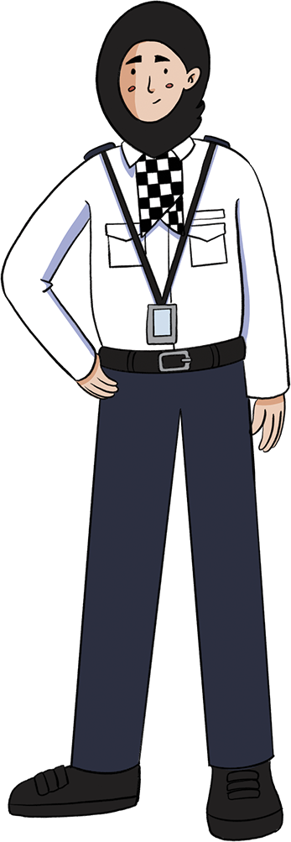
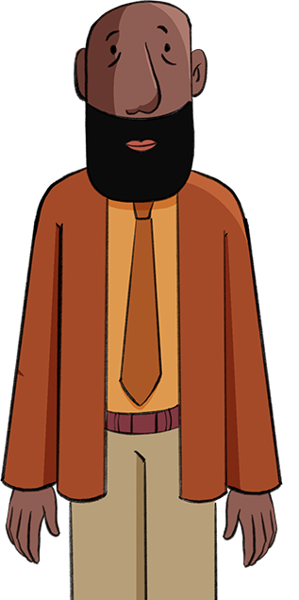
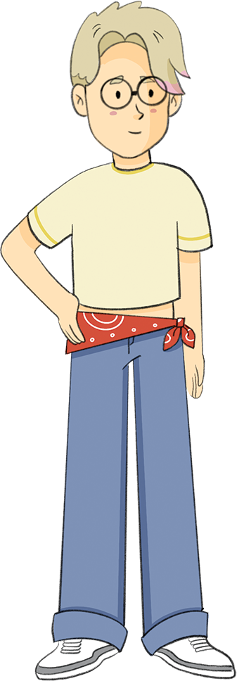
What is the Life Lessons approach?
Stories
Relatable, engaging and familiar characters that the children build relationships with.
We use stories to help young people prepare for the real world and understand other people.
Children are encouraged to share their own thoughts, feelings and experiences.
Through stories, children learn about different cultures and experiences - promoting understanding and compassion.

Slide 10
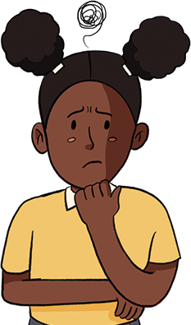


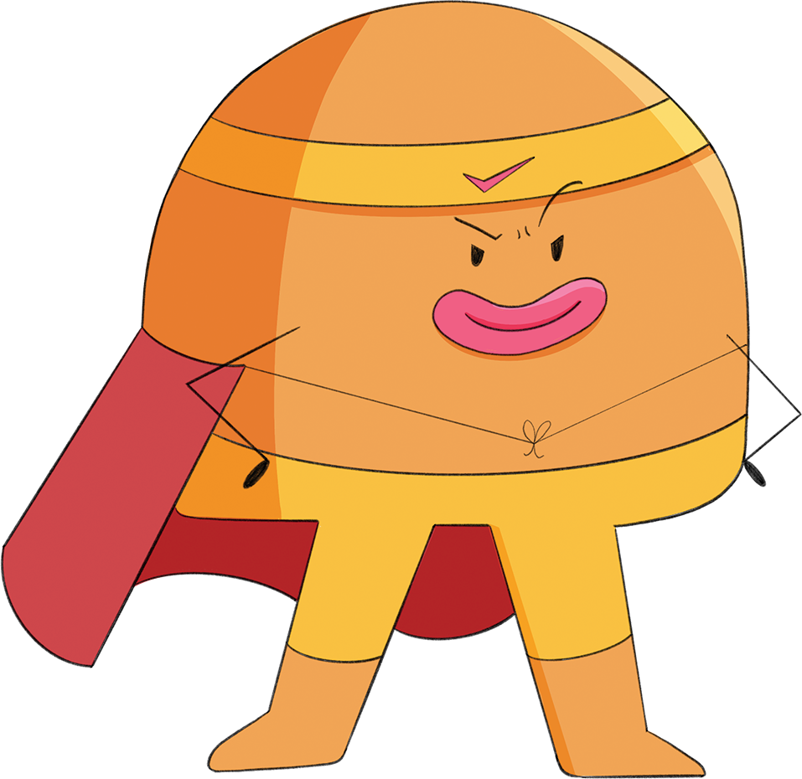
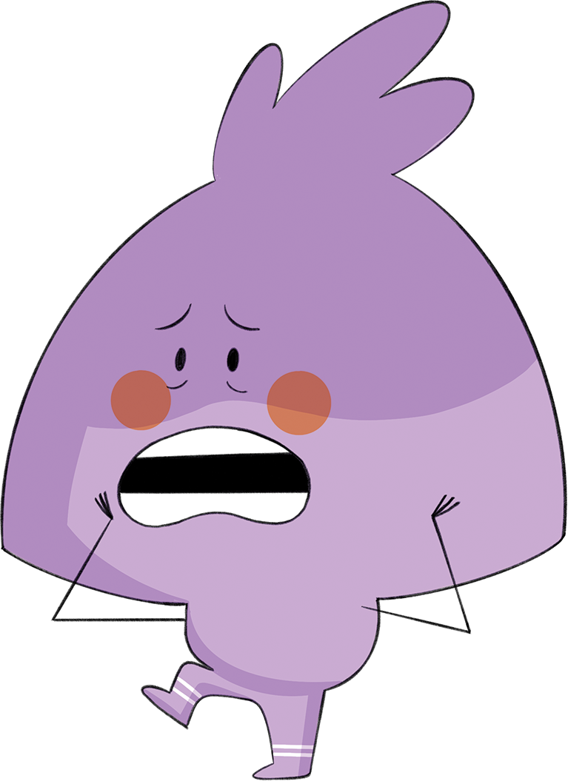
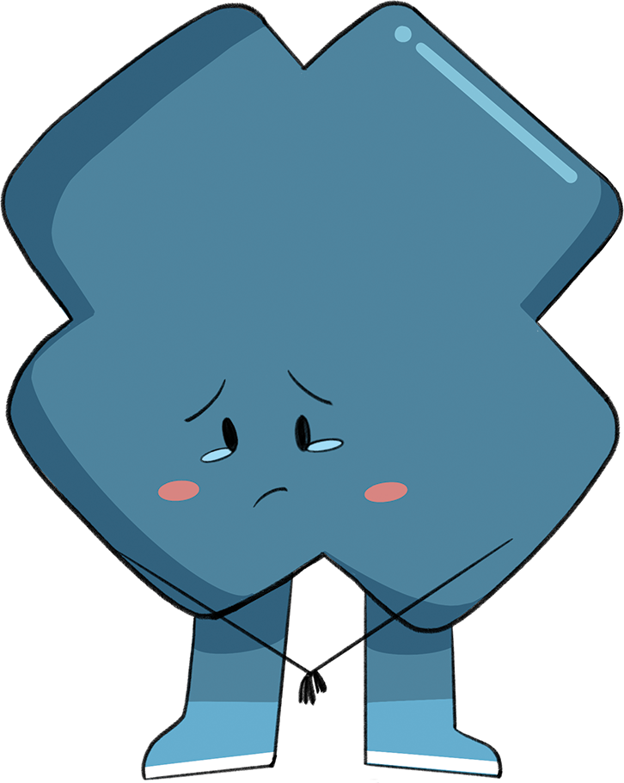
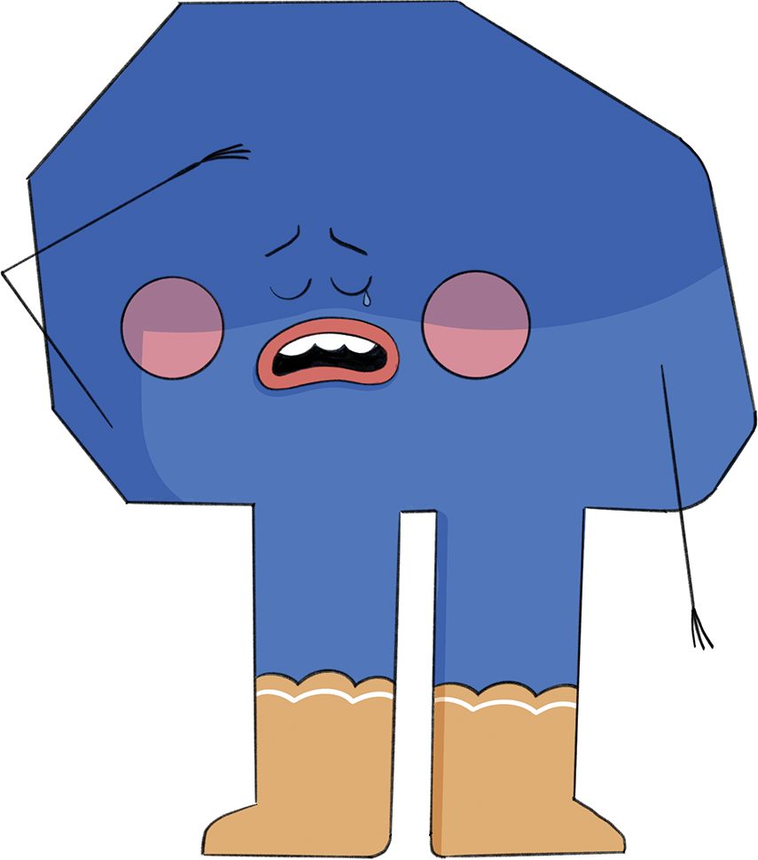
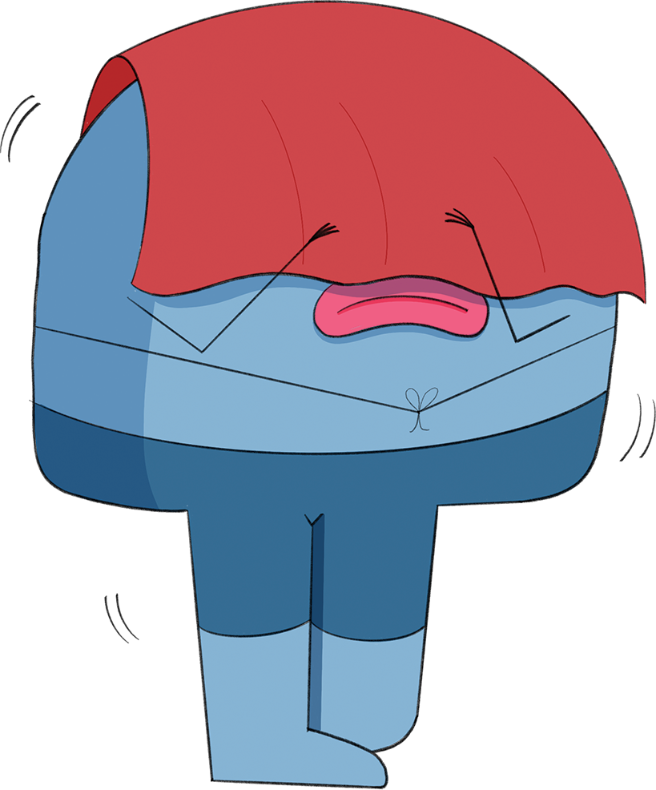
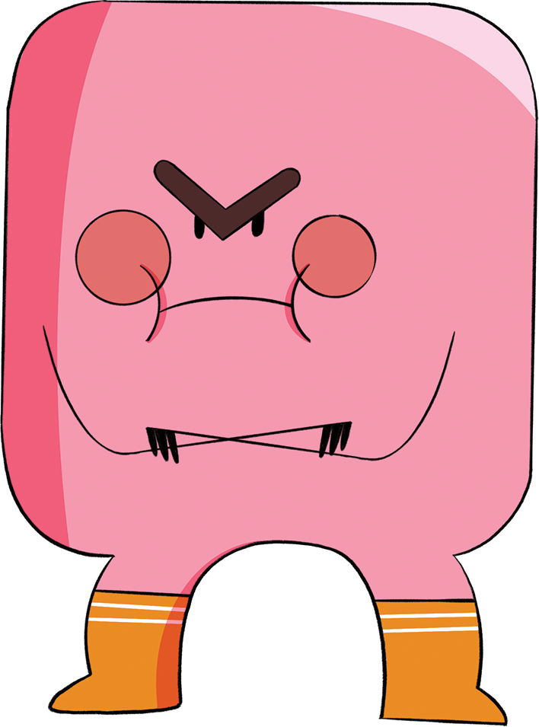
What is the Life Lessons approach?
Stories
We use stories to help young people prepare for the real world and understand other people.
We have a whole cast of emotions characters to help young people understand their own feelings.
Grumpy
Scared
Rejected
Confused
Disappointed
Confident
Unconfident

Slide 11
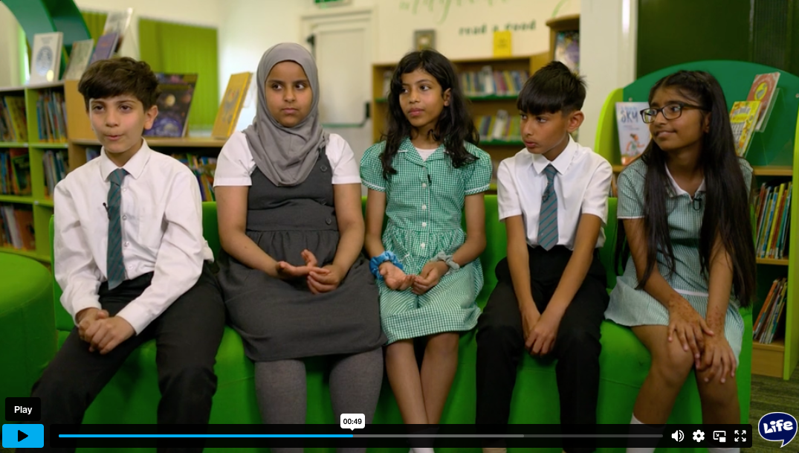
What is the Life Lessons approach?
Student-led
What does it mean to be addicted to something?
We want young people to feel like this is a curriculum for them and to develop their own voices and thoughts
https://vimeo.com/manage/videos/1098172728/9475cc6d60
Videos of children modelling discussions
Opportunities for young people to discuss ideas
A safe space for students to talk about their beliefs and feelings

Slide 12
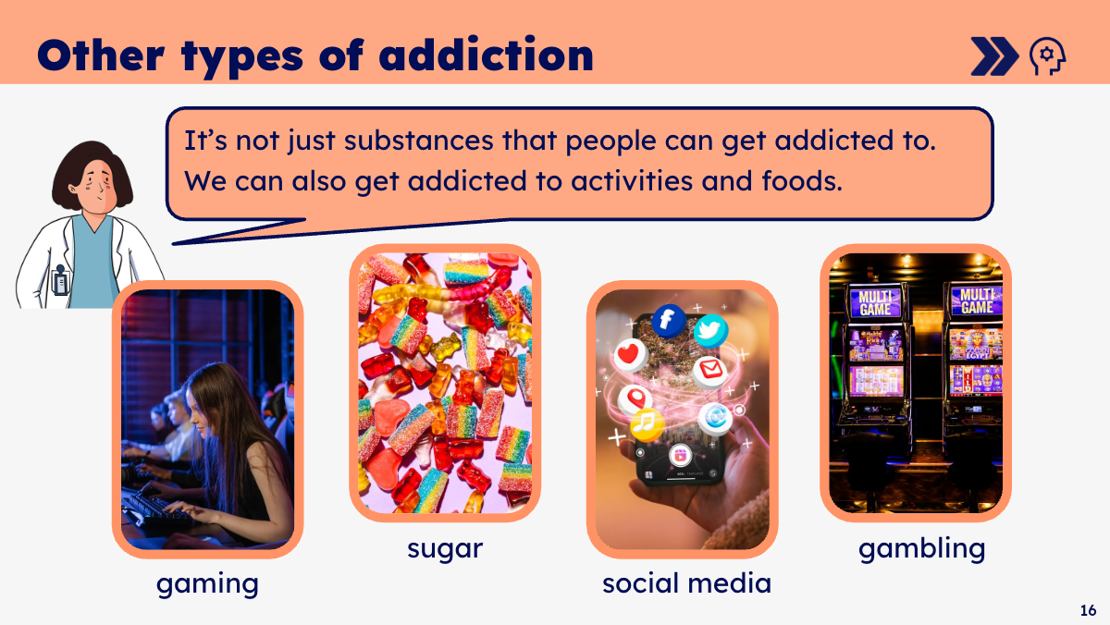
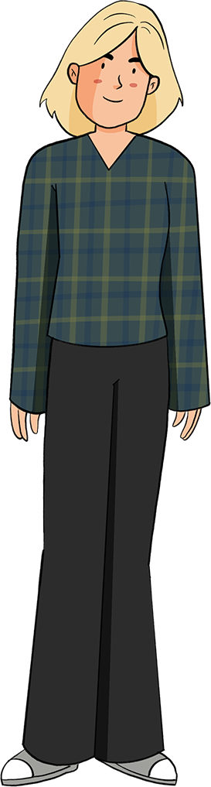
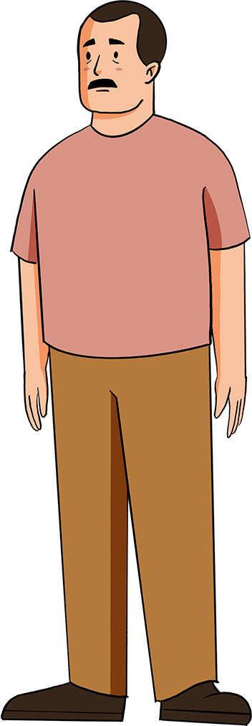
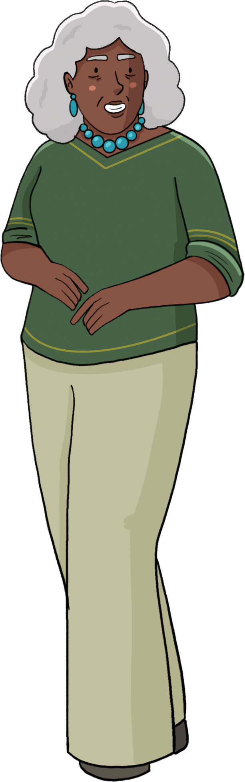
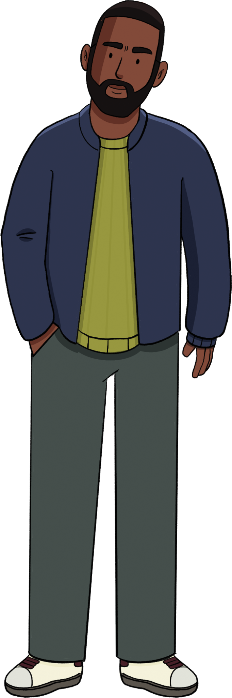
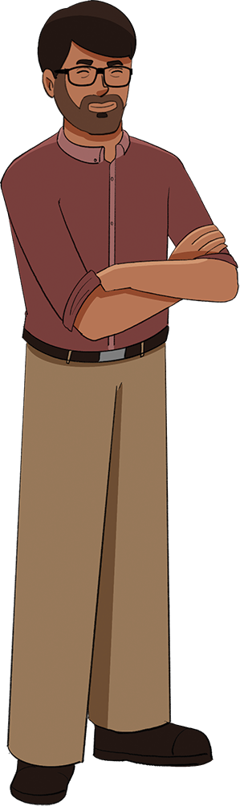
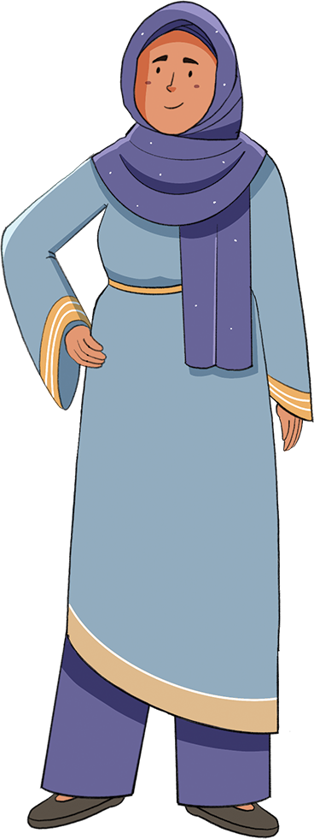
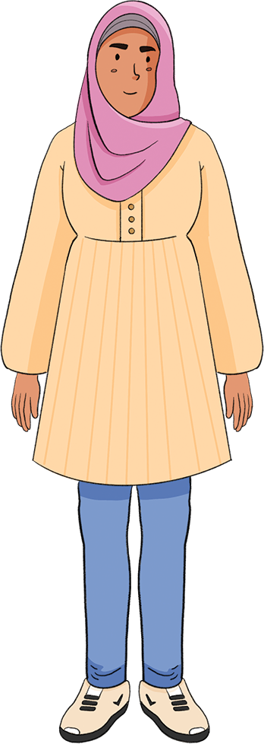
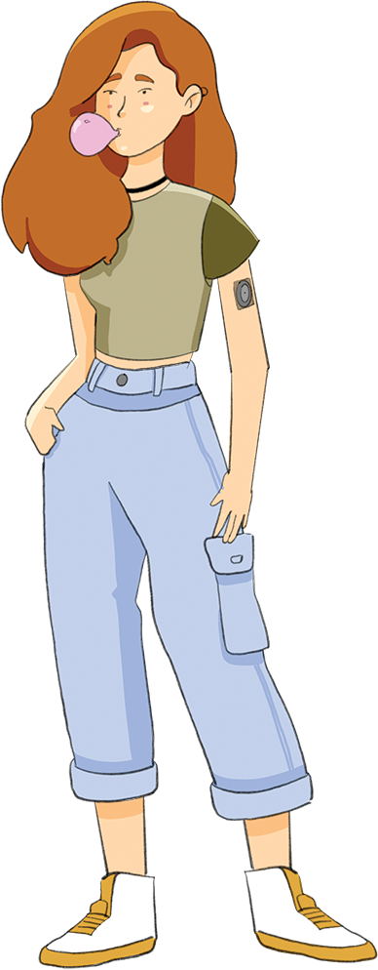
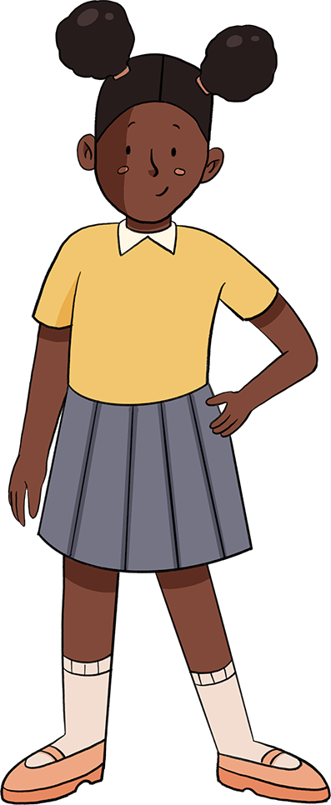
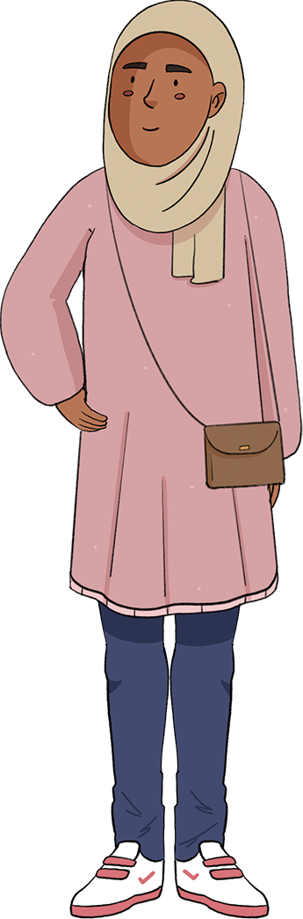
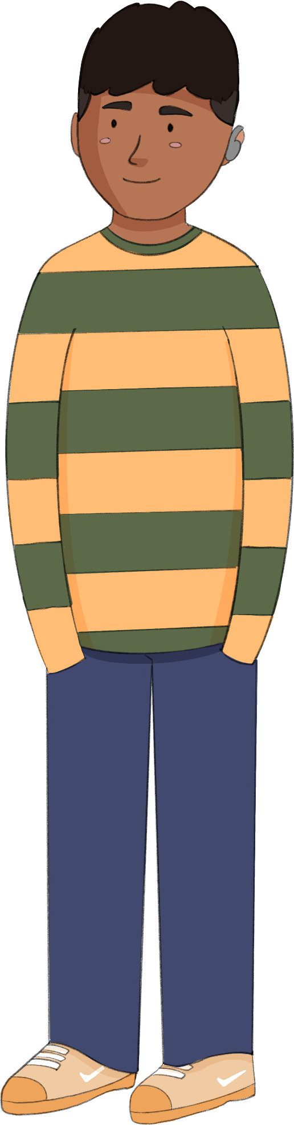
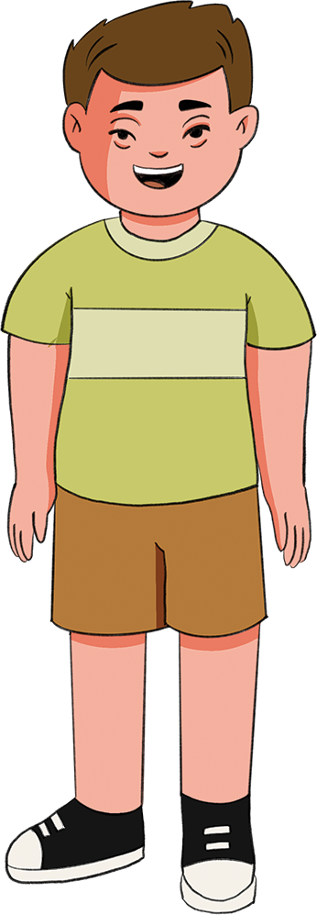
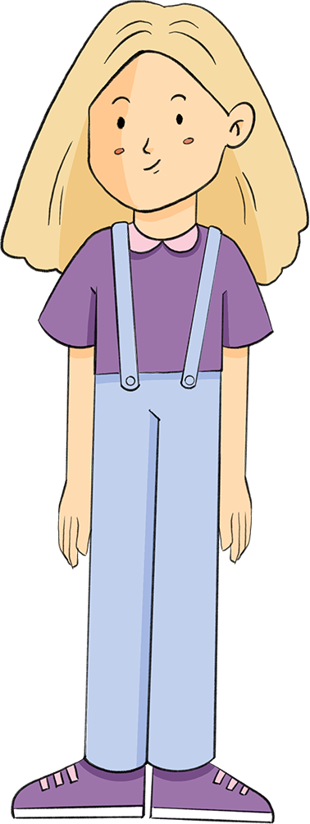
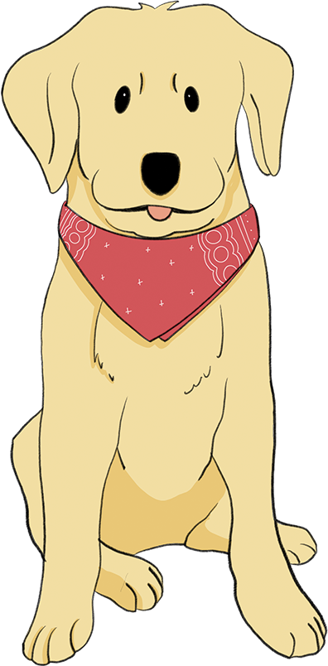
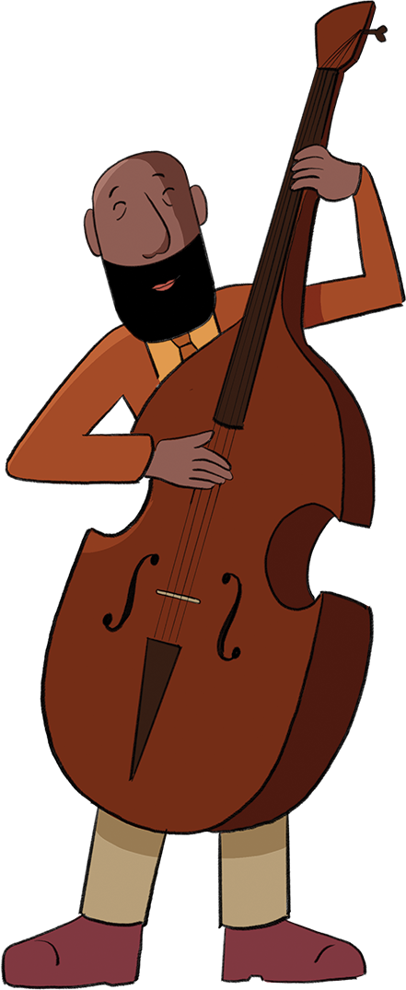
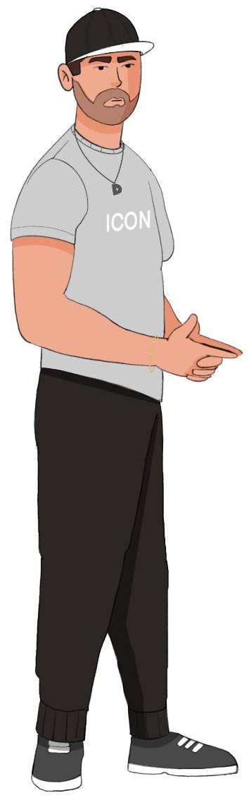
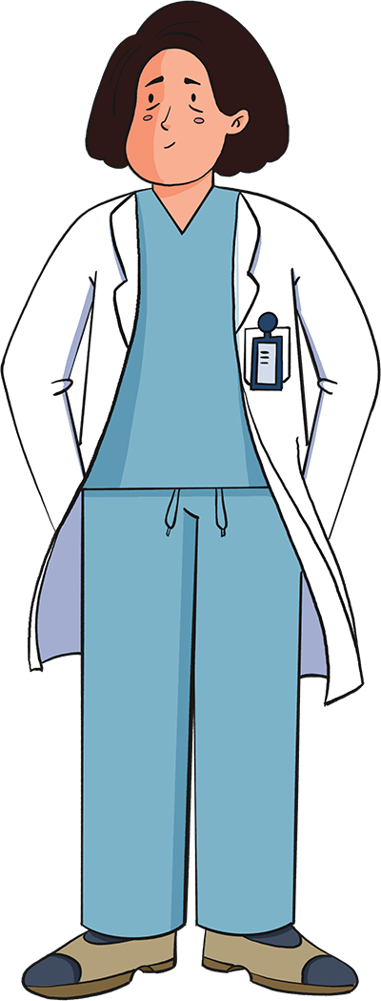
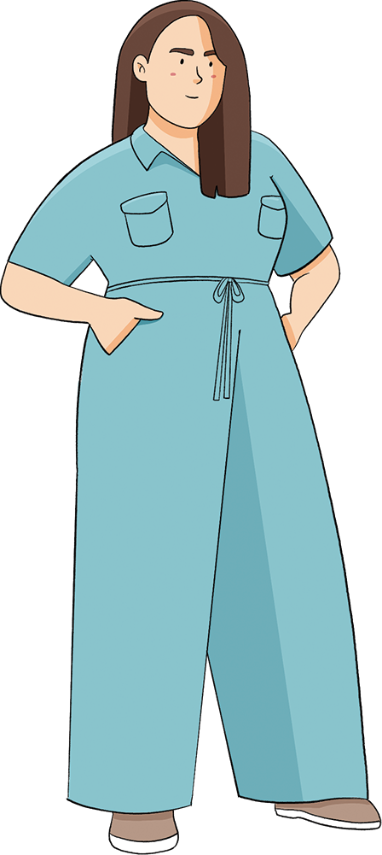
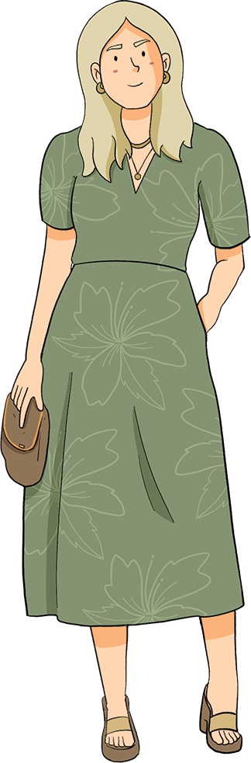
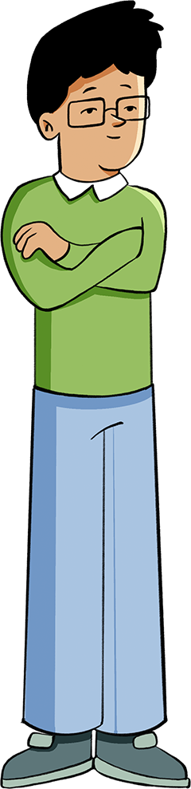
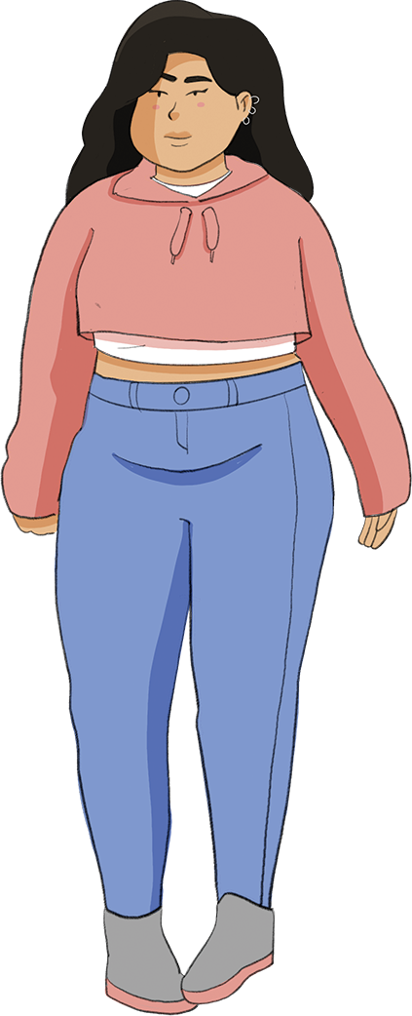
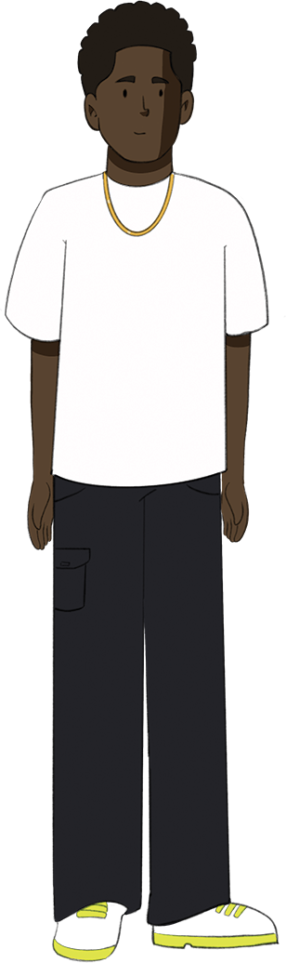
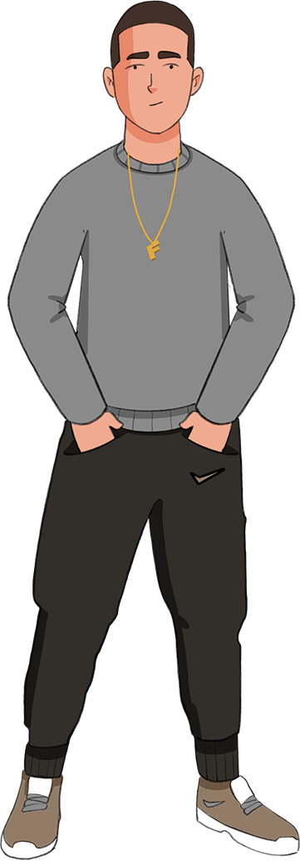
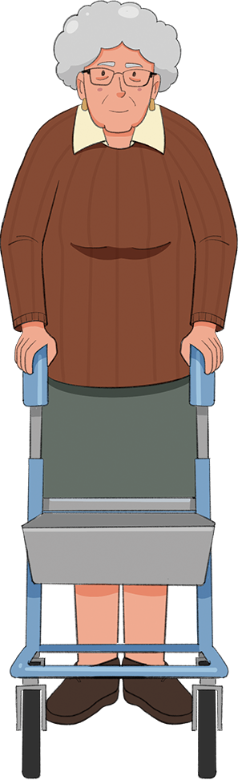
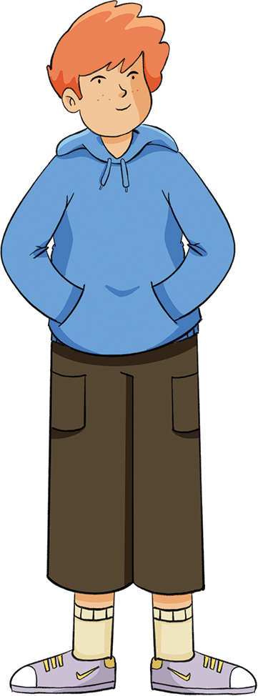
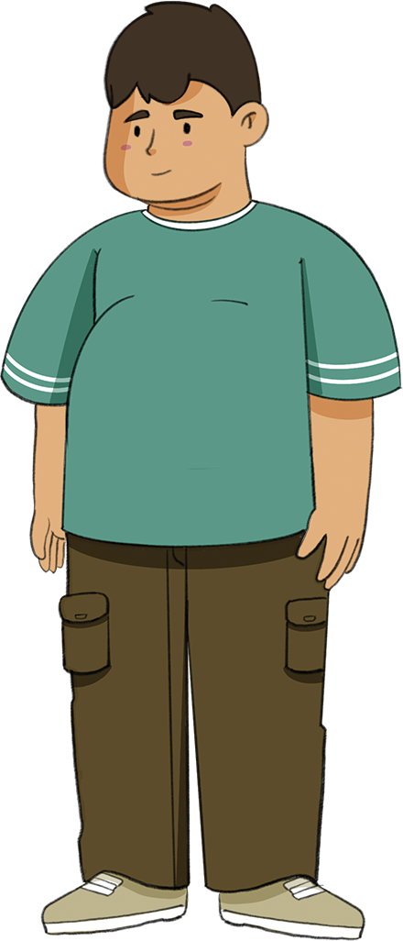
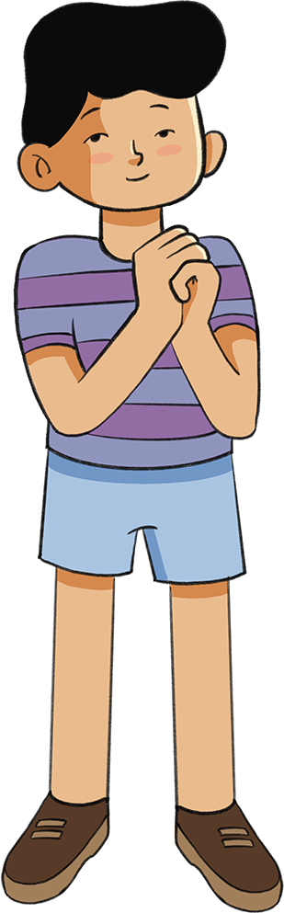
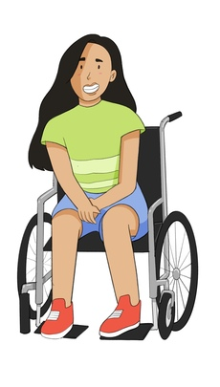
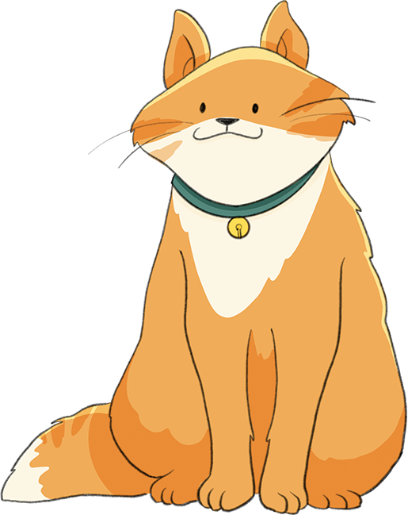
What is the Life Lessons approach?
Inclusive
Information broken down into small, simple ideas, to help all students understand
We want all students to learn and feel like they belong
Pages designed to be easy to read for pupils with visual impairments and dyslexia, with pictures to support those who find reading tricky
Diversity represented and celebrated

Slide 13
What is the Life Lessons approach?
Relational
We help students to understand their relationships with the people in their lives.
People learn through the relationships with the people around them.
Self within the world
Self with others
We support young people to understand themselves and how they fit in to the world around them
Understanding myself

Slide 14
What will Life Lessons help your child to do?
Aspire to and dream of a bright future
Feel like they belong and be proud of their heritage and values
Have healthy relationships
Make healthy choices and stay safe
Understand the world around them
Understand their emotions and feel good about themselves

Slide 15
Wellbeing
Wellbeing is one of the most important things to get right in primary school. We cover many different aspects of wellbeing, such as…
Lifestyle choices
Diet
Exercise
Mental health
Emotional regulation
Loneliness
Resilience to challenges and changes
Self-esteem

Slide 16
What content is covered?
Drugs, alcohol, tobacco and vaping
Intimate and sexual relationships, including sexual health
(Optional, starting in year 6)
Social media and online information
Body image and self-esteem
Communities and belonging
Sexual reproduction (optional until year 11)
Dreams, careers, ambitions and money
Physical and mental wellbeing
Healthy relationships
Values, heritage and identity
Menstruation, puberty and body image
Identifying and finding support for abusive relationships
Anti-discrimination
Resilience and sense-of-self
For specific information about the statutory content, please refer to this audit document.

Slide 17
What is the curriculum structure?
Understanding myself |  |  | Self with others | Self within the world
Physical wellbeing Mental health Understanding our emotions The way we grow and change during puberty Making choices to stay safe and well Drugs, alcohol and tobacco |  |  | Families Friendships Reducing hurtful behaviour and bullying Identifying safe and unsafe relationships Respecting self and others Fixing or leaving relationships that have gone wrong | Responsibilities and power Understanding other people: how we are the same and how we are different (including the Equality Act) Media and the online world Economic wellbeing: Money Dreams, work, careers and volunteering
Wellbeing | Healthy choices | My body & Me | Healthy Relationships | Identity & Community | Digital Lives | Aspiration & money
A detailed breakdown of the content for each year group can be found in this document.

Slide 18
Life skills - taught in every lesson
Empathy
Oracy
Mental Strength & Resilience
Critical Thinking
Emotional Literacy

Slide 19
How do we deal with sensitive topics?
We know that some topics are particularly sensitive, because of cultural, political or religious reasons.
healthy relationships
different families
consent
(non sexual in primary)
puberty
gender
All content is covered in an age-appropriate way, and support both the statutory RSHE guidance and the Equality Act.
The purpose of teaching these topics is to help young people to discuss important issues, and understand their own values and beliefs.

Slide 20
How do we deal with sensitive topics?
When we understand the background to conflicts and disagreements, we can stop disagreements turning into arguments:
We live in a world where people can have very different opinions to each other.
Despite these differences, it is possible to be accepting, tolerant and respectful
The Life Lessons curriculum teaches skills that build respect and compassion for all people.

Slide 21
How do we deal with sensitive topics?
We need skills to discuss these sensitive topics. The Life Lessons curriculum helps young people to…
…understand and explain their own thoughts, beliefs and emotions.
…listen to other people and accept difference.
…find common ground with all people.

Slide 22
How do we deal with sensitive topics?
Other key skills that children learn through the Life Lessons curriculum include…
…seeing both sides in an issue.
…thinking deeply, kindly and critically.
…making connections between their own and other people’s experiences (building empathy).

Slide 23
How do we deal with sensitive topics?
We know that social media can cause people to feel isolated, biased, frustrated and like they don’t belong. Therefore, we teach young people to…
…guess the motivations of content creators.
…identify bias.
…verify information they read online.

Slide 24
Sex education
The Life Lessons curriculum includes resources to teach sex education, in line with government guidance. Parents have the right to withdraw their children from these lessons if they wish. Details of which topics count as sex education can be found in the school’s RSHE policy.
Letters will be sent in upperschool when this content is due to be covered and parents can notify us if they would like to withdraw their child from some or all of the optional sessions.
These lessons focus on the basics of human intercourse and reproduction, including age-appropriate information about how sexual intercourse and fertilisation happens. The resources use a factual scientific approach, and do not discuss the details of intimate sexual relationships, beyond the biology of intercourse, the basics of sexual consent and the law.

Slide 25
How can you support your child around these issues?
Find out what topics they are covering each term.
Ask them questions related to these topics.
Help them understand how your family’s values and beliefs connect to the topics covered.
Try to listen without judgement, so they feel safe to share their feelings and ideas, and feel comfortable to ask for your support in understanding the topic.
Let them know what you think about the topic yourself, and also make space for them to ask questions and form their own opinions too.

Slide 26
Key contacts in school
PSHE/RSHE lead – Megan Coombs
Designated safeguarding lead – Amy Symons
You child’s class teacher
SENDCo – Vikki Moore

